Slide 1
User-Defined Primitive (UDP)

Slide 2
INTRODUCTION
Till now we have used the built-in primitive gates provided by Verilog HDL.
But Verilog HDL has the capability of specifying user-defined primitives (UDP).
A UDP is instantiated exactly the same way as a primitive gate, that is, the syntax for an UDP instantiation is identical to that of a gate instantiation.

Slide 3
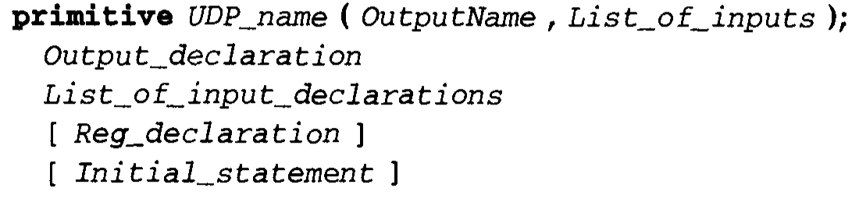
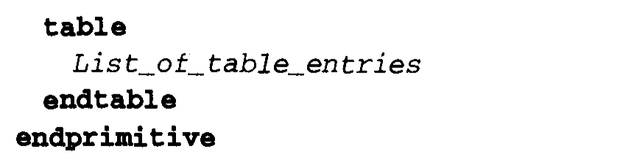
Defining a UDP
A UDP is defined using a UDP declaration which has the following syntax.

Slide 4
A UDP definition does not depend on a module definition and thus appears outside of a module definition.
A UDP definition can also be in a separate text file.
A UDP can have only one output and may have one or more inputs.
The first port must be the output port.
In addition, the output can have the value 0, 1 or x (z is not allowed).If a value z appears on the input, it is treated as an x.
The behavior of a UDP is described in the form of a table.
The following two kinds of behavior can be described in an UDP.
Combinational
Sequential (edge-triggered and level-sensitive)

Slide 5
1. Combinational UDP
In a combinational UDP, the table specifies the various input combinations and their corresponding output values.
Any combination that is not specified is an x for the output.

Slide 6
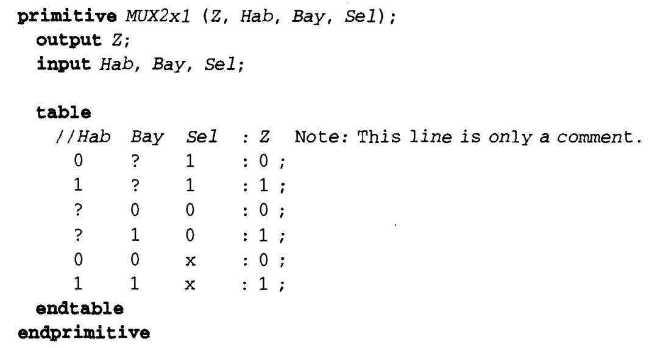

Slide 7
The ? character represents a don't-care value, that is, it could either be a 0, 1 or x.
The order of the input ports must match the order of entries in the table, that is, the first column in the table corresponds to the first input in the module port list (which is Hab), second column is Bay and the third column is Sel.
In the table for the multiplexer, there is no table entry for one input combination 01x (there are others as well);in this case, the output defaults to an x (as also for other unspecified entries)

Slide 8
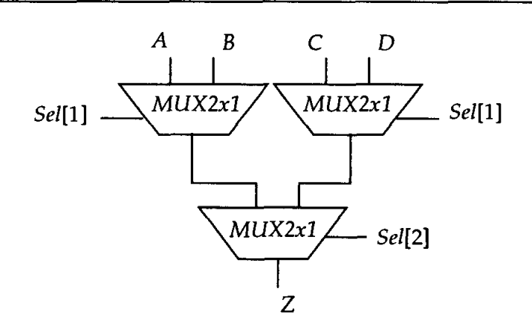
4-to-1 multiplexer using 2-to-1 multiplexer primitives
TL
TP

Slide 9
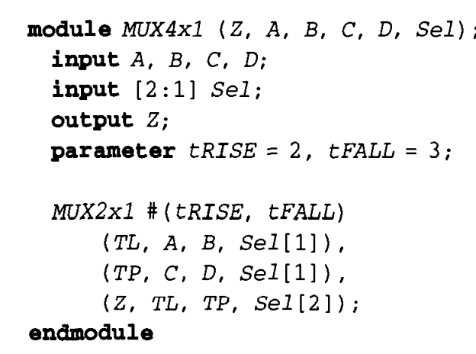

Slide 10
2. Sequential UDP
In a sequential UDP, the internal state is described using a 1-bitregister.
The value of this register is the output of the sequential UDP.
There are two different kinds of sequential UDP, that models
level sensitive behavior
edge-sensitive behavior.
A sequential UDP uses the current value of the register and the input values to determine the next value of the register (and consequently the output).

Slide 11
Initializing the State Register
The state of a sequential UDP can be initialized by using an initial statement that has one procedural assignment statement.
This is of the form:
This initial statement appears within the UDP definition.

Slide 12
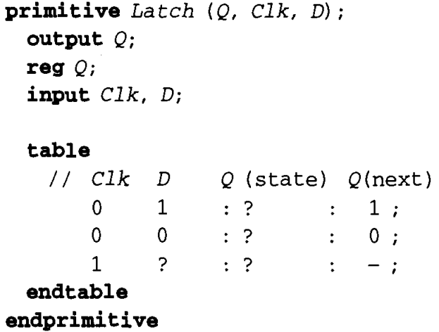
Level-sensitive Sequential UDP
Example of a level-sensitive sequential UDP that models a D-type latch.
As long as the clock is 0, data passes from the input to the output, else the value remains latched.
The – character implies a \"no change\".
Note that the state of the UDP is stored in register Q.

Slide 13
Edge-triggered Sequential UDP
Here is an example of a D-type edge-triggered flip-flop modeled as a edge-triggered sequential UDP. An initial statement is used to initialize the state of the flip-flop.
The table entry (01) indicates a transition from 0 to 1, the entry (0x) indicates a transition from 0 to x, the entry (?0) indicates a transition from any value (0, 1, or x) to 0, and the entry (??) indicates any transition. For any unspecified transition, the output defaults to an x.

Slide 14
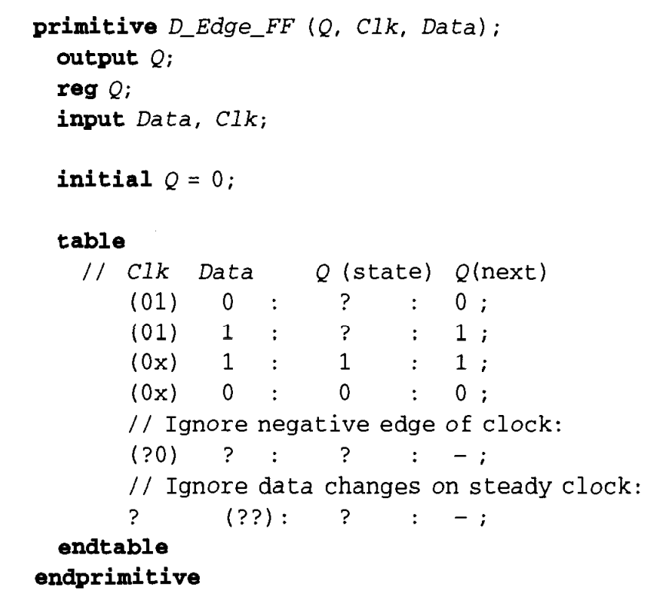

Slide 15
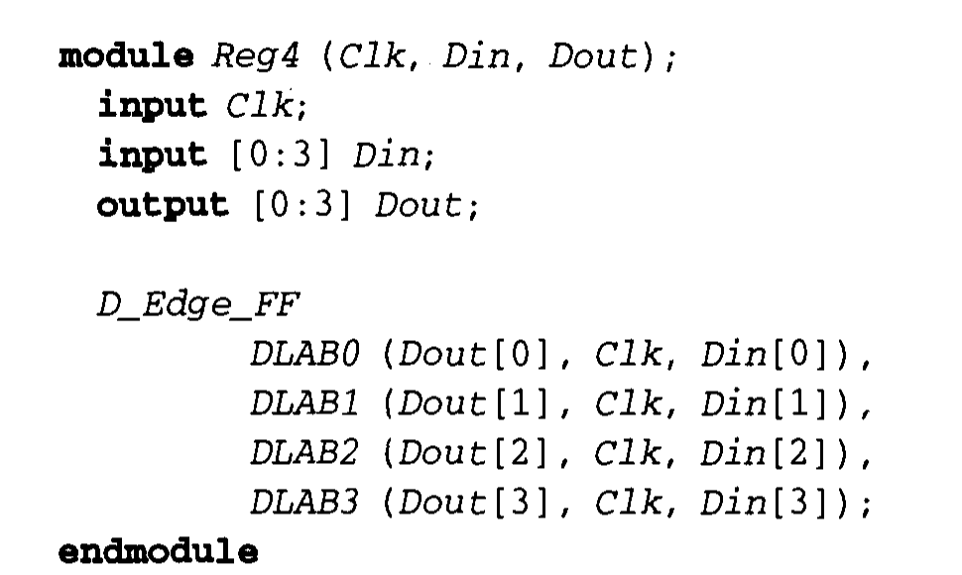
Design of a 4-bit register using the D_Edge_FF UDP

Slide 16
Mixing Edge-triggered and Level-sensitive Behavior
It is possible to mix level-sensitive entries and edge-triggered entries in one table.
In such a case, the edge transitions are processed before the level sensitive ones are processed, that is, the level-sensitive entries override the edge-triggered entries.
Here is an example of a D-type flip-flop with an asynchronous clear

Slide 17
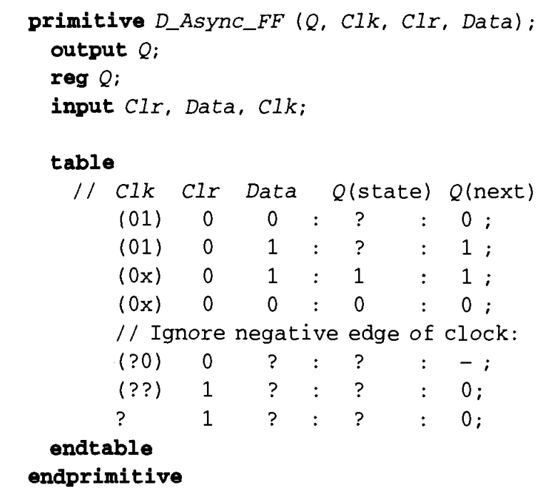

Slide 18
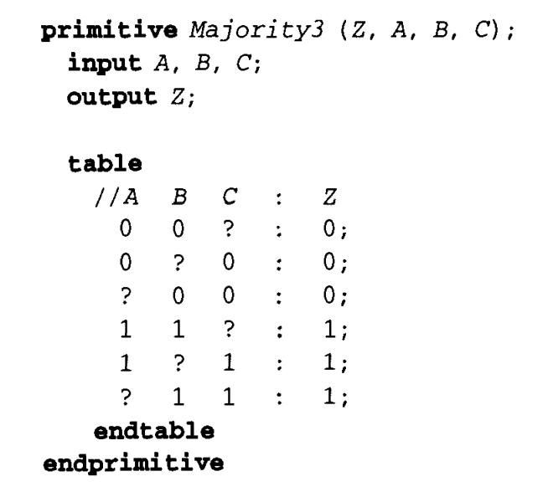
Q. Design a UDP description of a 3-bit majority circuit. The output is 1 if the input vector has two or more1's.

Slide 19
THANK YOU

